Slide 1


MMID: Spatial Models
Dr Sheetal Silal

Slide 2
Spread of Infectious Diseases
“Globalization appears to be causing profound, sometimes unpredictable, changes in the ecological, biological and social conditions that shape the burden of infectious diseases in certain populations. There is accumulating evidence that changes in these conditions have led to alterations in the prevalence, spread, geographical range, and control of many infections, particularly those transmitted by vectors. ”
-Special Topics in Social, Economic and Behavioural (SEB) Research, WHO
http://www.who.int/tdr/publications/documents/seb_topic3.pdf

Slide 3
Spatial models
How can space affect the spread of disease?
Localised transmission ➔ most of the population is not exposed to infection immediately upon its introduction
Clique behaviour – reduces the opportunity for secondary infections
Fadeouts are not permanent. Linkages may result in resurgence of infection
Particularly if epidemics occur at different times/rates in different locales

Slide 4
Spatial models
Is it necessary to include spatial variation?
Demographic & disease parameters may vary
Environmental/receptivity may vary
Ability to deploy interventions may vary
Mobility patterns (within and without) may vary

Slide 5
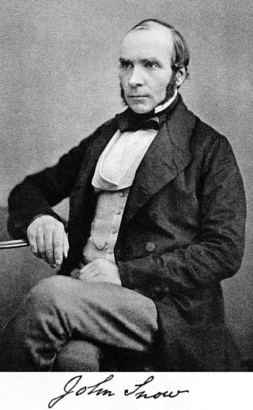
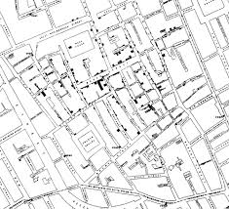
1854 London Cholera epidemic
Notes:
Pg 88 sattanspiel The geographic spread of Infectious diseases – chapter 4

Slide 6
How to model space
Continuous Space
Reaction-diffusion equations (stochastic processes)
Discrete space
Coupled lattice/Cellular automata models
Coupled metapopulation models
Mobility models

Slide 7
Spatially Continuous Models
Continuous time-Continuous space models
Assumption: Population is continuously distributed across space
Spatial location is represented by x and densities of S and I populations given by S(x,t), and I(x,t)
Mathematically amenable, but mostly theoretical use
Reaction-diffusion model

Slide 8
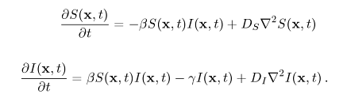
Spatially Continuous Models
Reaction Diffusion model
2nd order partial differential equation system
Speed of diffusion governed by D_{S} and D_{I}

Slide 9
Discrete Time-Discrete Space
Cellular Automata Models
Consist of cells on a grid that may change colours at discrete times to represent different states.
A cell’s state is determined by a set of rules and the state of its neighbours, and therefore the neighbourhood of a cell must be specified.
SIR models can be set up in this manner

Slide 10
Cellular Automata Models
Cellular Automata Model for Epidemics
^{Sharon Chang}
^{UC Davis Physics}

Slide 11
Metapopulation Models
Population is divided into n spatially explicit groups that are linked to each other
Groups called Metapopulations/patches/sub-populations
Individuals within a patch are homogenous or well mixed
Spatial scale depends on the context of the study
Cross coupled models

Slide 12
Metapopulation Models
Cross-coupled models
No explicit movement
Movement effect is mimicked mathematically
Mobility models
Direct movement is modelled

Slide 13
Metapopulation Models
Coupling Patterns
Strength of interactions designated by modeller
Contact matrix
WAIFW (Who acquires
infection from whom)
E.g. equal between
group coupling

Slide 14
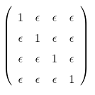
Equal between group coupling
Degree of interaction between groups < interaction within groups
Interactions are symmetric
ε – scaling factor
Transmission rate β is found:
multiply β_{n} by element in coupling matrix

Slide 15
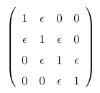
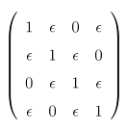
Metapopulation Models
Coupling Patterns
Nearest Neighbour coupling
Groups arranged linear fashion
Nearest Neighbour coupling
Groups arranged circular fashion

Slide 16
Metapopulation Models
Coupling Patterns: SIR Model equations
Inverse distance weighted coupling

Slide 17
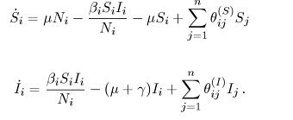
Metapopulation Models
Mobility models
Specify a per capita rate of movement
Temporary/permanent movement
n*(n-1) parameters! (1/2 if symmetric)

